Slide 1







WP2: Map deconstruction aids 3D model construction
Mark Jessell¹, Vitaliy Ogarko², Mark Lindsay¹, Ranee Joshi¹, Lachlan Grose³, Laurent Ailleres³, Miguel de la Varga⁴, Guillaume Pirot¹
¹ Mineral Exploration Cooperative Research Centre, School of Earth Sciences, UWA, Perth, Australia
² International Centre for Radio Astronomy Research, UWA, Perth, Australia
³ School of Earth, Atmosphere and Environment, Monash University
⁴Computational Geoscience and Reservoir Engineering, RWTH Aachen, Germany
mark.jessell@uwa.edu.au
Busselton March 2020

Slide 2
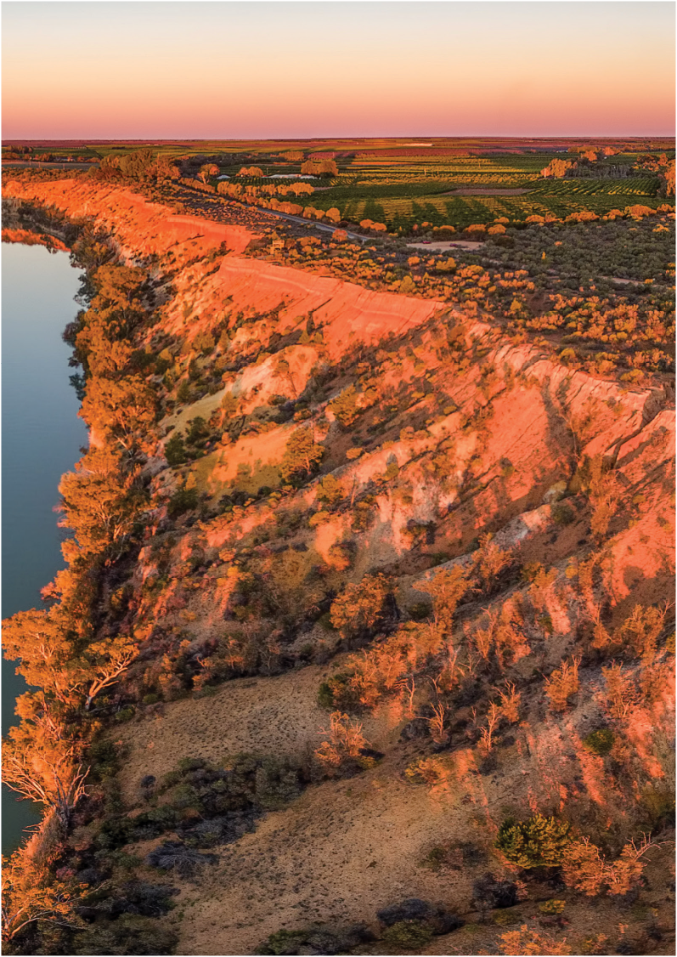
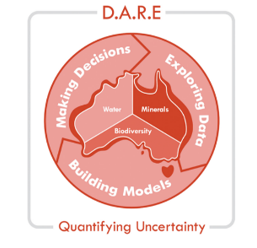
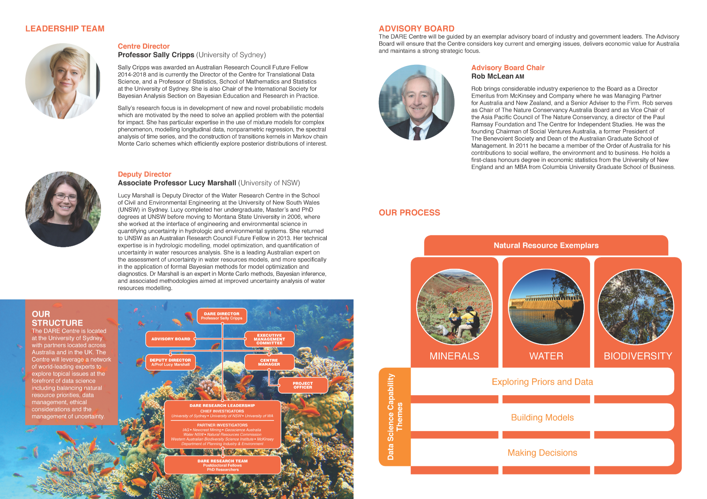












DARE
Data Analytics for
Resources and Environments
An Australian Research Council Industrial Transformation Training Centre
www.darecentre.org.au
Centre Director
Dr Sally Cripps
U of Sydney
?
?

Slide 3
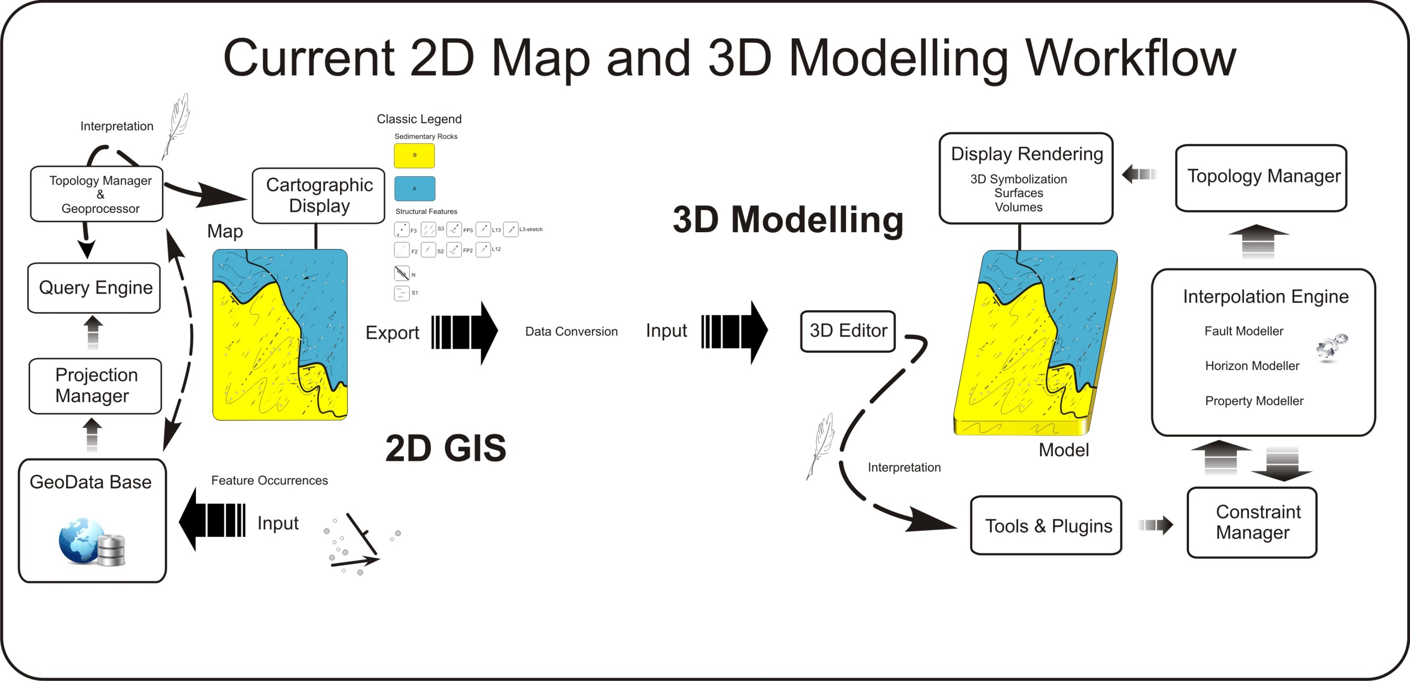
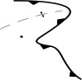
One-way one-model !
WP2
EDK
WP2 will provide Loop with the ability to directly access online and offline geoscientific datasets, which it will then process to extract the data required for 3D Geological Modelling. This includes re-projection, upscaling, information extraction and exporting in native formats aimed at a variety of implicit 3D Geological modelling engines.
Notes:
How do we currently make our 3D models, a quick generalization is worth reflecting on. In the end we follow a linear workflow. Models are rarely used to update a primary data store with new relationship or insight. All new knowledge is embedded in the model.

Slide 4
Principles:
Accept structured data as-is
allows real-time modelling
Modify on the fly
reproject, upscale, derive missing information, define conceptual constraints
Iteratively define all parameters needed to build a model so that they can be front-loaded into map2loop
ensures reproducibility

Slide 5
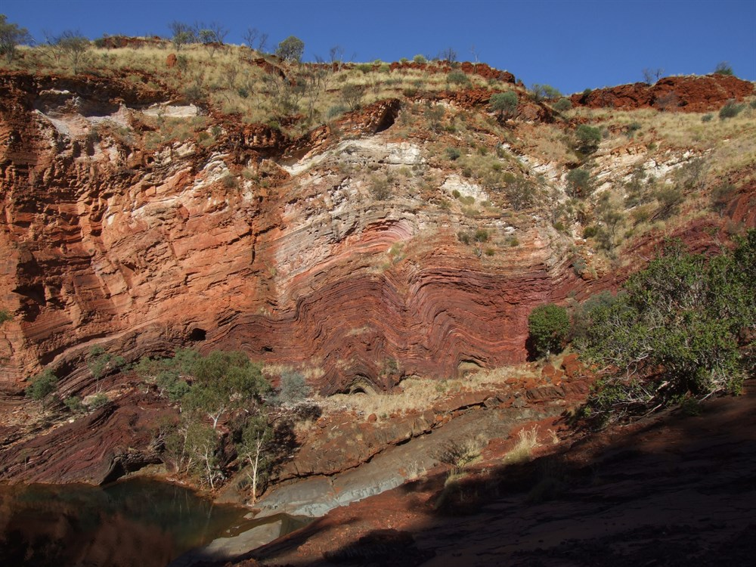
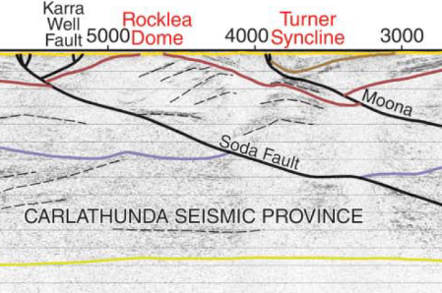
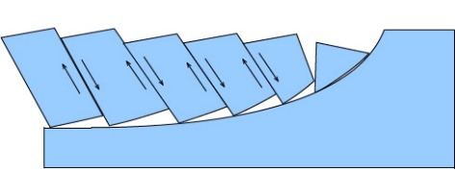
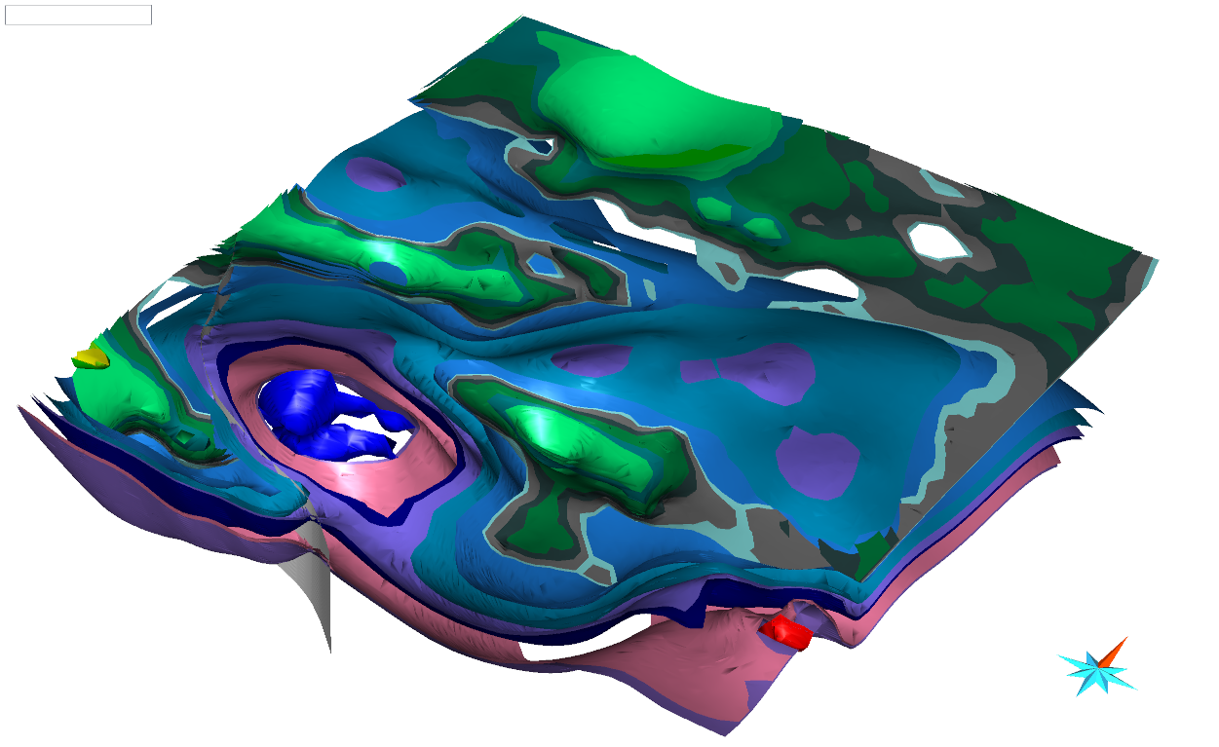
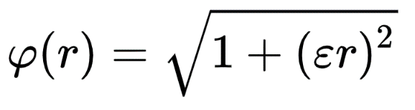
Ingredients of a 3D geological model (and sources of uncertainty)
Observations
Interpretations
Concepts
Algorithms

Slide 6
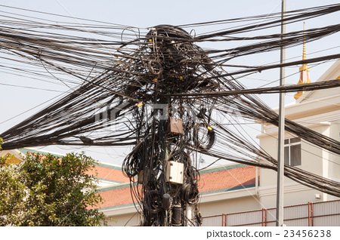
Current 3D Modelling Workflow
Observations
Concepts
Interpretations
Algorithms

Slide 7
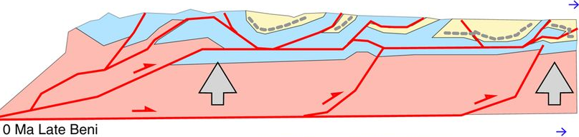
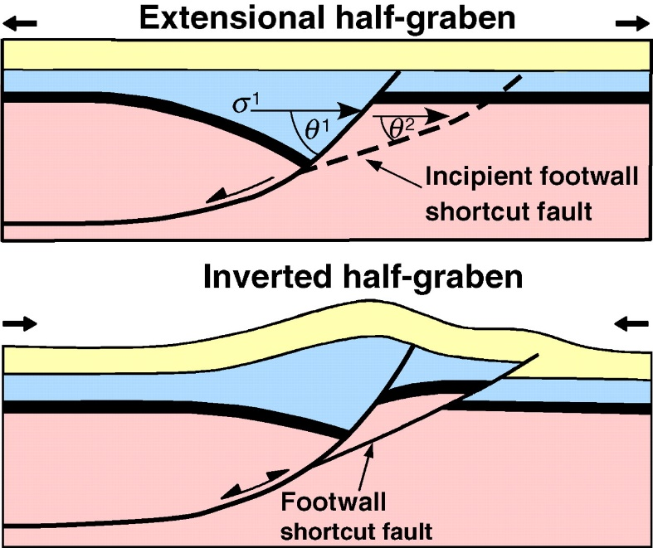

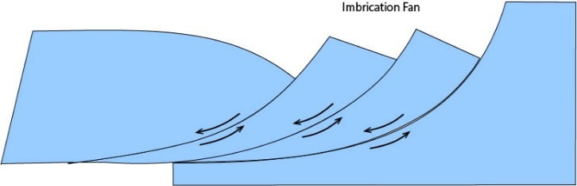
Prior concepts about region (faults)
Without limited geophysical constraints, the sub-surface geometry of faults is often ‘solved’ by applying a pre-conceived notion based on vertical, listric, flower or negative flow, fold & thrust geometries.

Slide 8
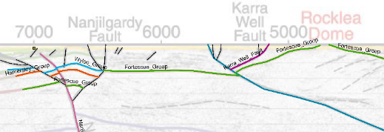
Prior concepts about region (faults)

Slide 9
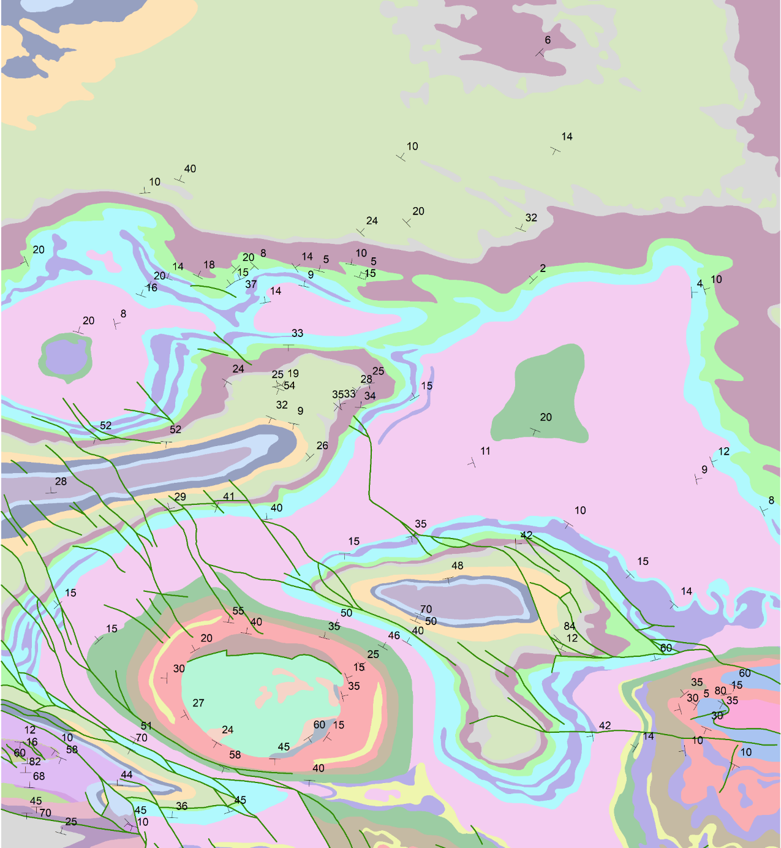
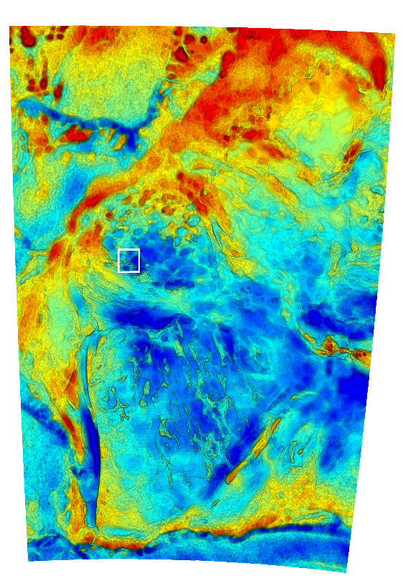
Two end-member regional 3D modelling scenarios:
Geological constraints come FIRST
GSWA 500K
Interpreted Bedrock Geology
1 degree square

Slide 10
Two end-member regional 3D modelling scenarios:
Geological constraints come FIRST
Under cover, so geophysics is FIRST constraint
Qs
GSWA 500K IBG

Slide 11
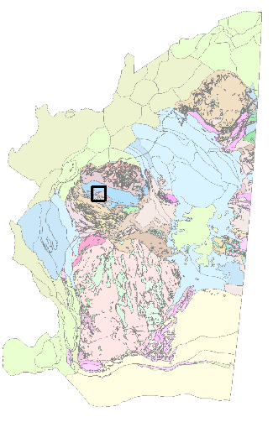
Loop Information Manager
map2loop
3 layers available via WFS
at geo.loop-gis.org/geoserver
Geology polygons (GSWA 500k IGB)
Fault polylines (surface trace, state)
Structural points (bedding, local area)
DTM online from GA

Slide 12
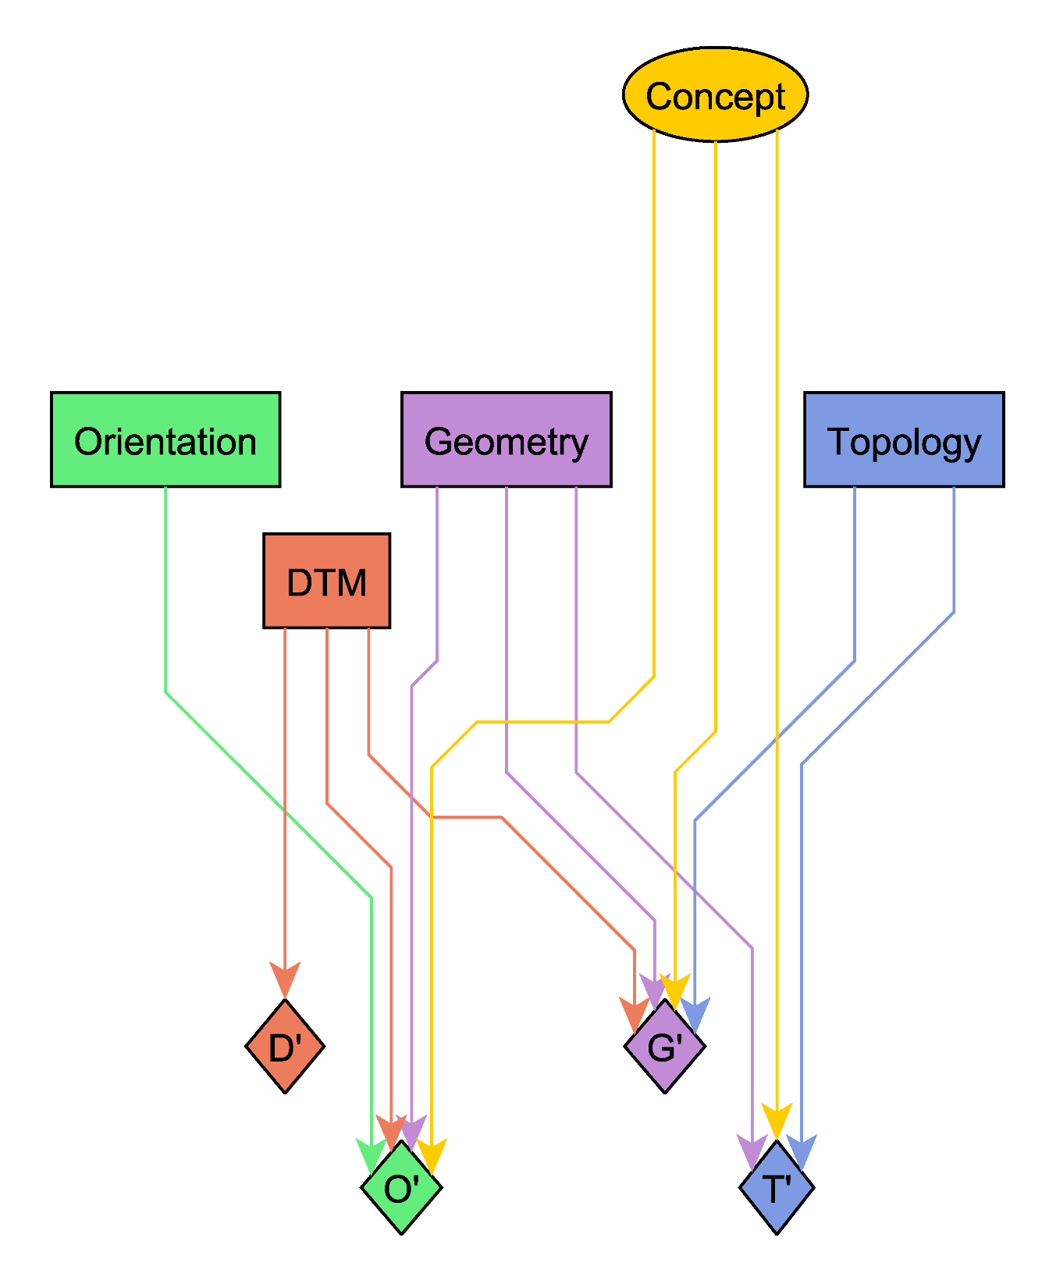
Concepts:
What is the geological framework in this region?
Observations:
Gradient
Position
Topology
DTM
Outputs:
Selected Observations
Subsampled Observations
Derived measurements
Gradient
Position
D’
P’
G’
T’

Slide 13
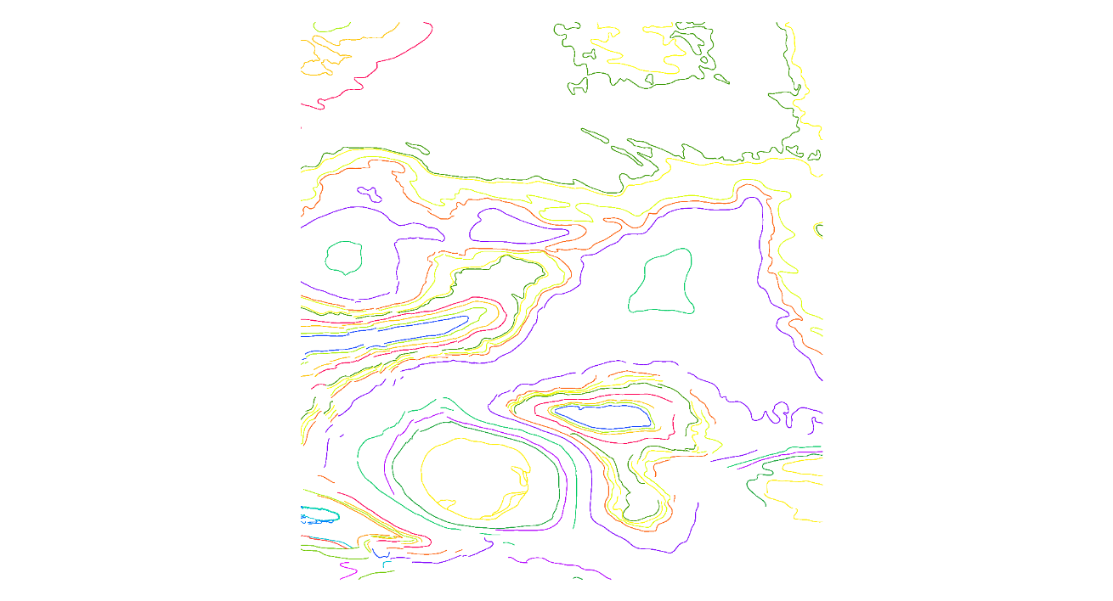
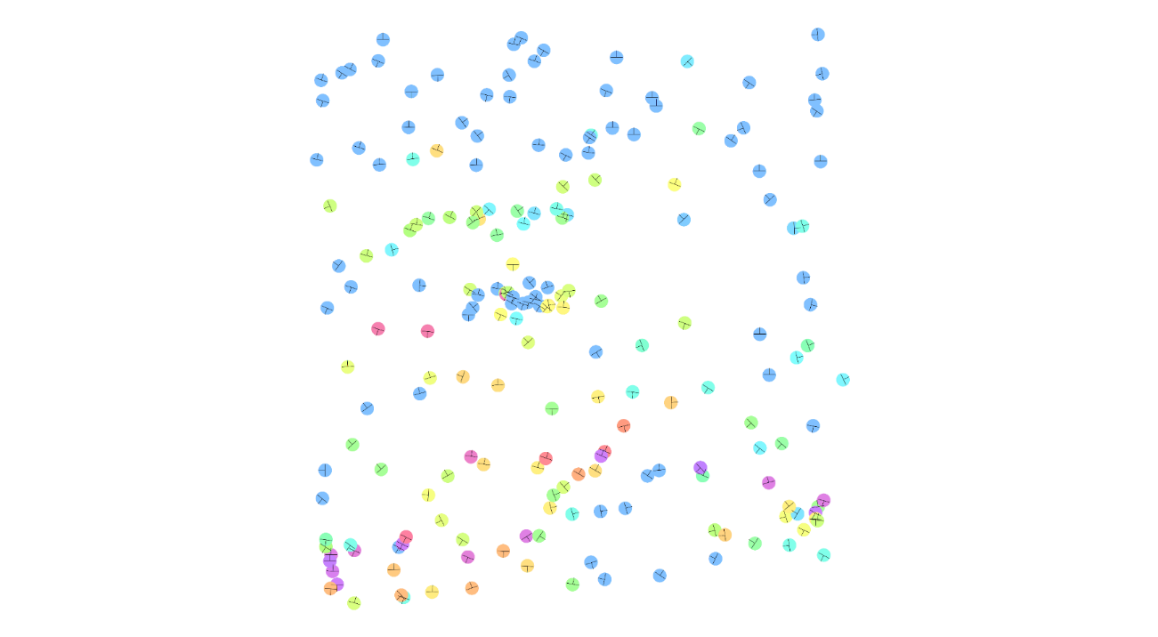
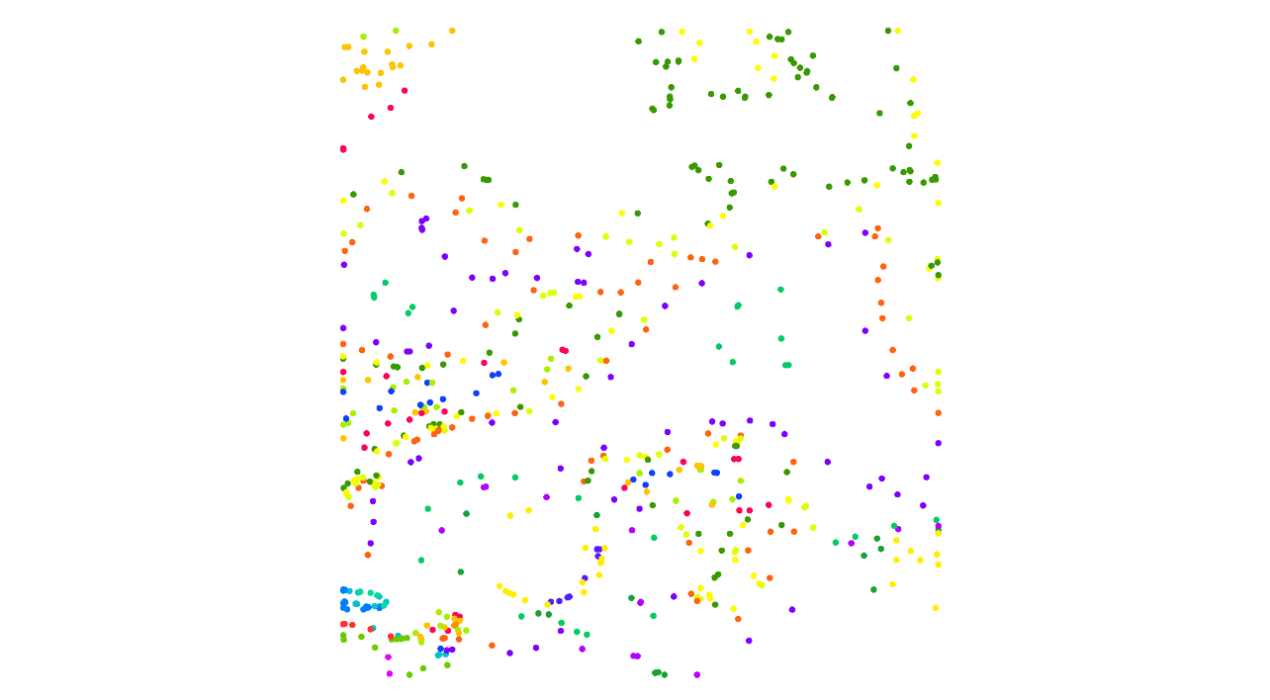
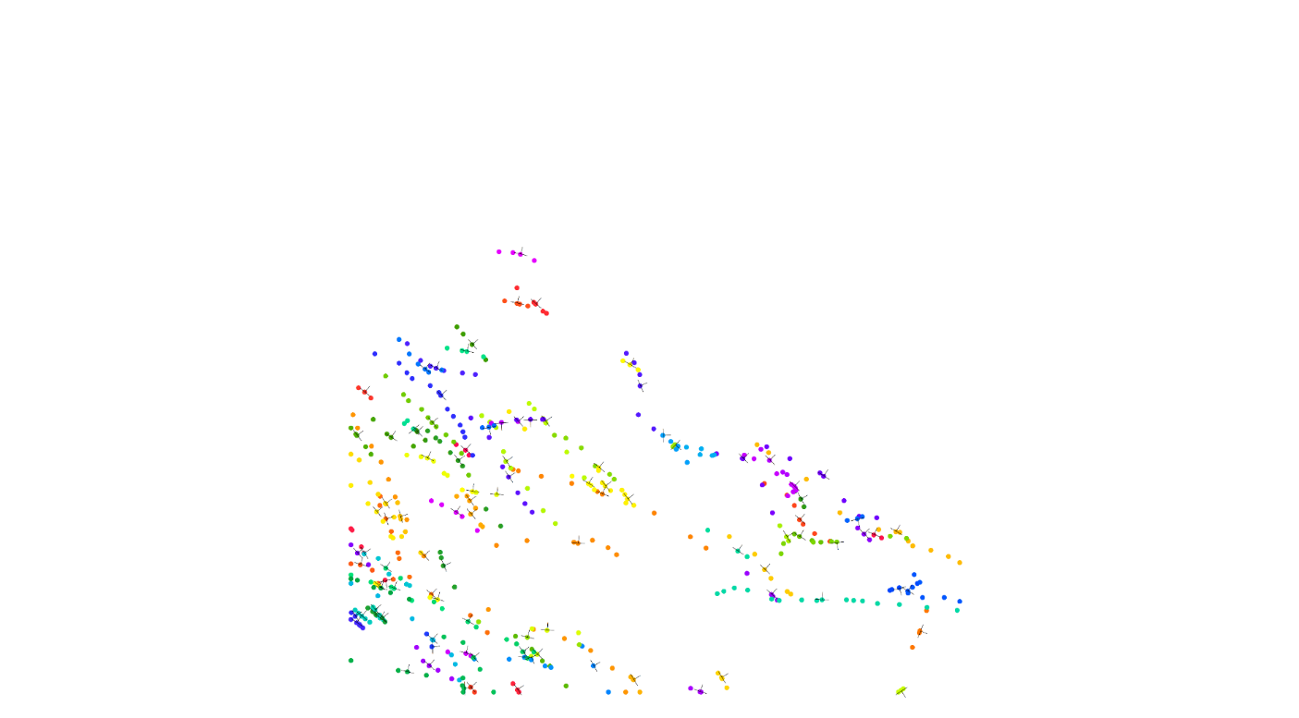
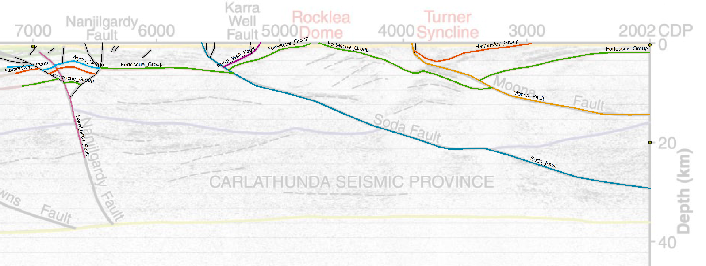
Automated Geometry
Structures
Contacts
Faults
Seismic Interpretation
(10GA-CP1)

Slide 14
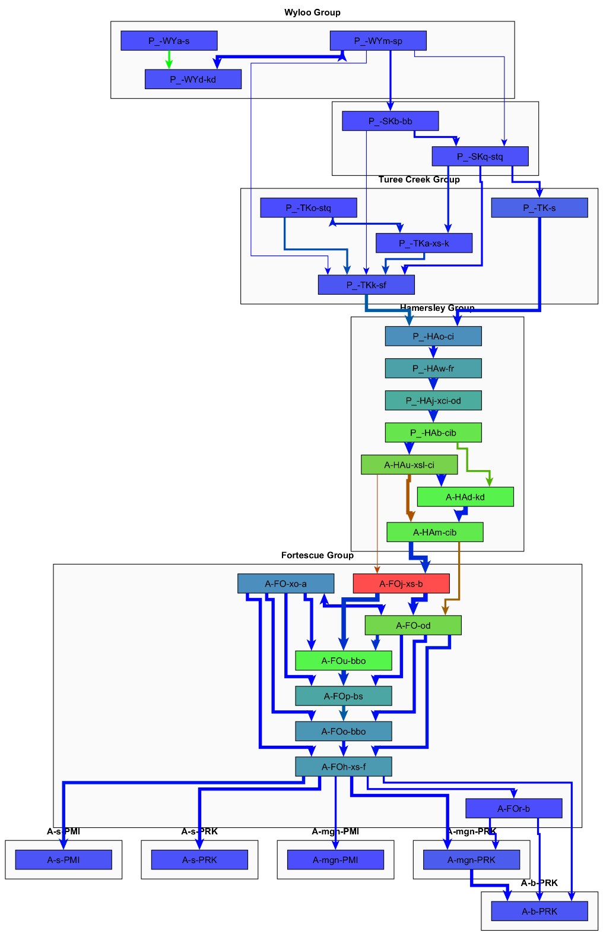
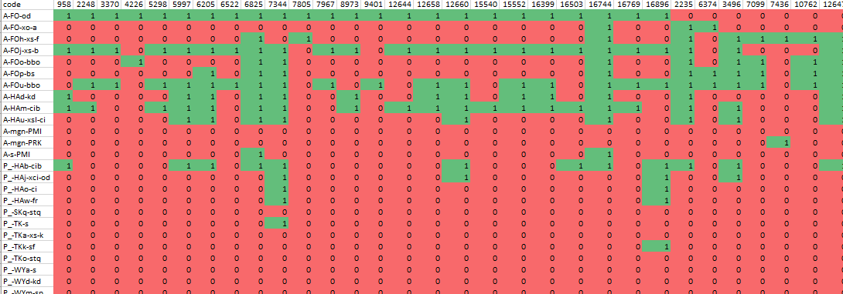
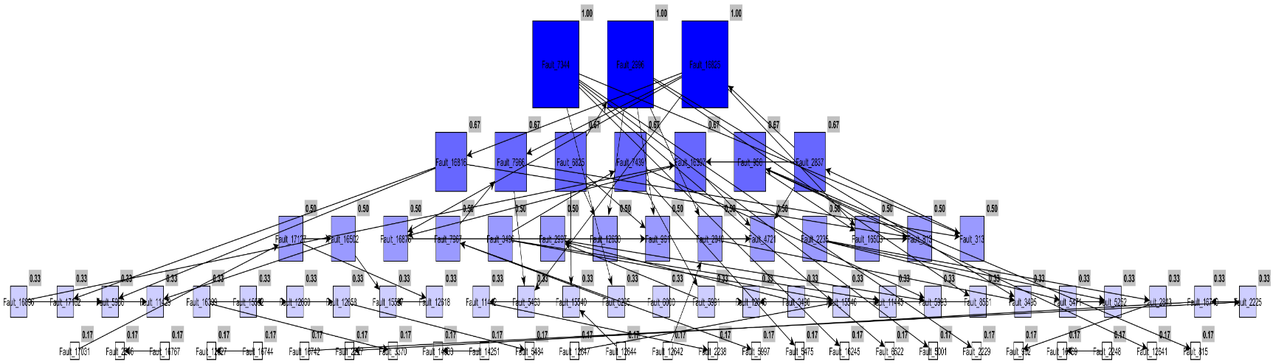
Automated Topology
Stratigraphic
relationships
Fault/Stratigraphy Relationships
Fault/fault
relationships
Number of connected edges

Slide 15
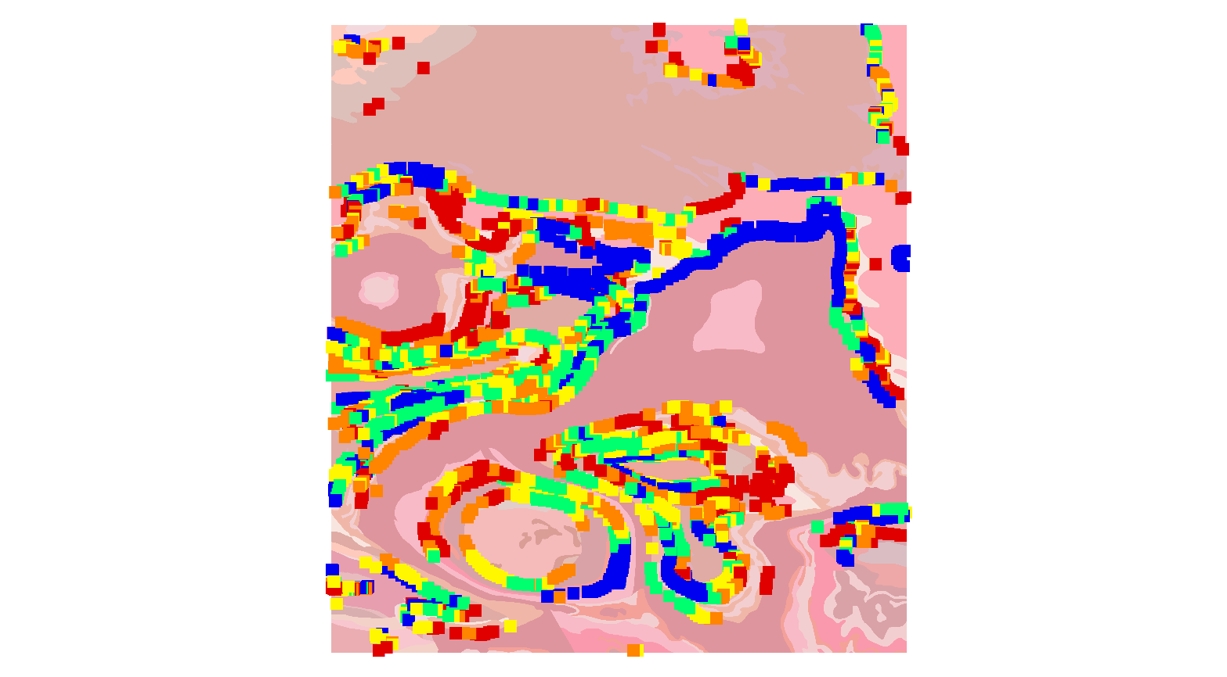
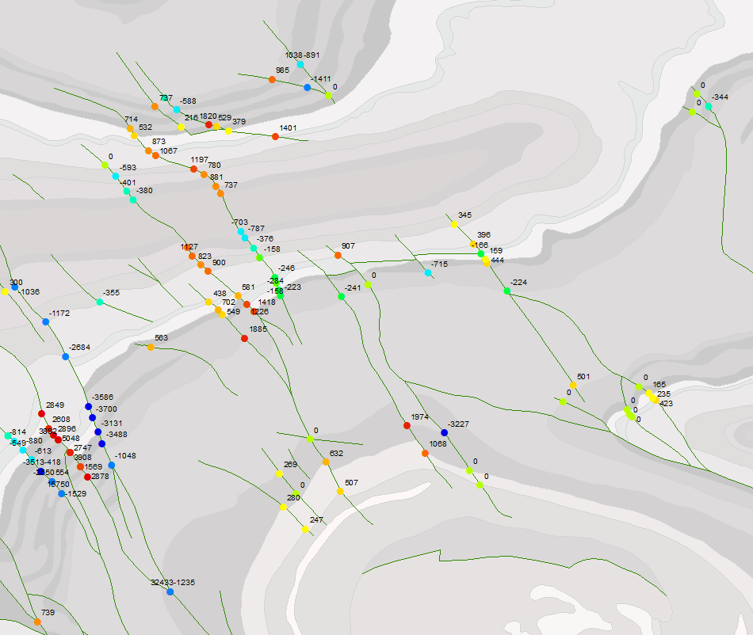
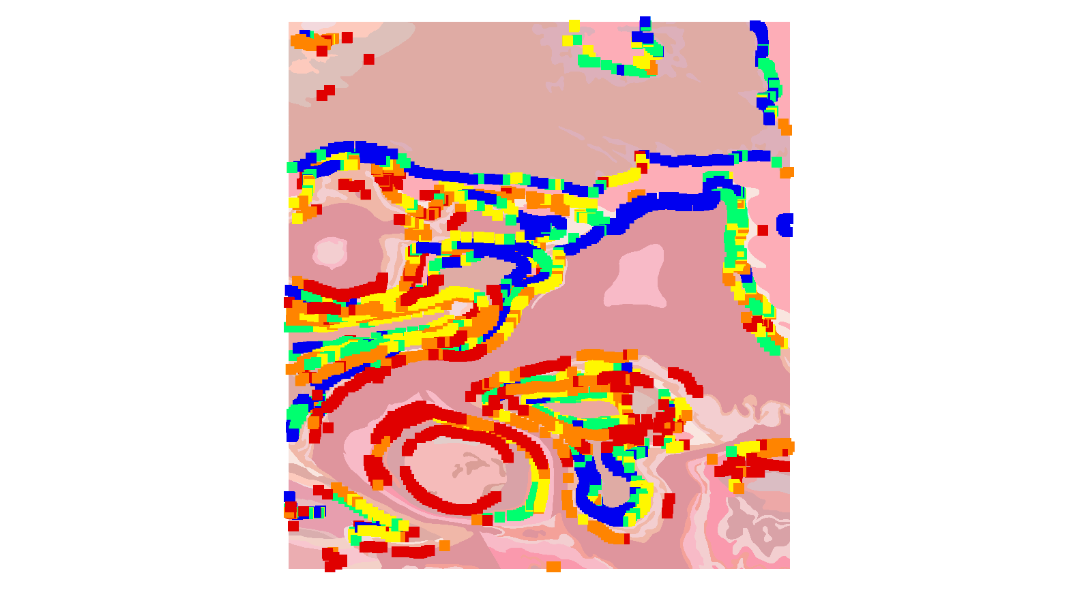
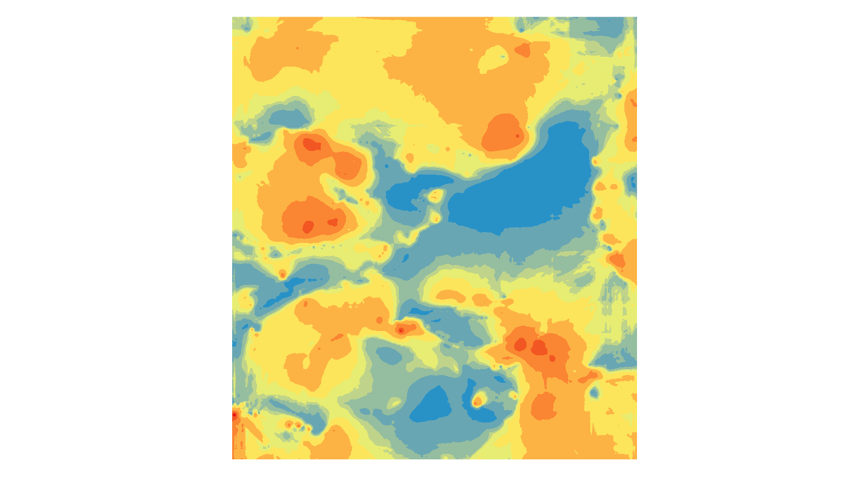
Automated Analysis
Apparent fault throw
Estimated Unit Thickness

Slide 16
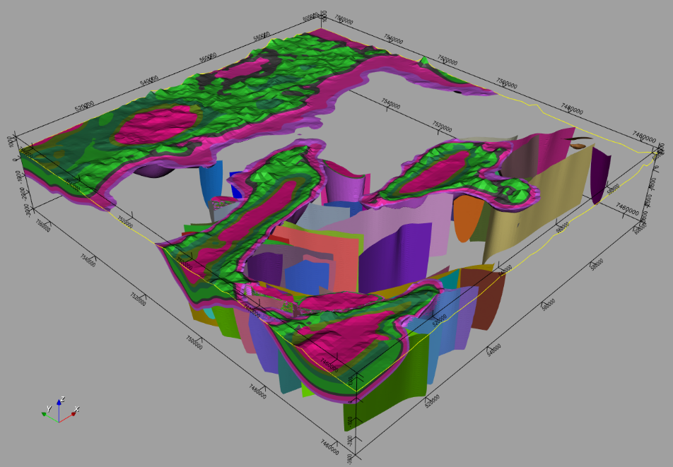
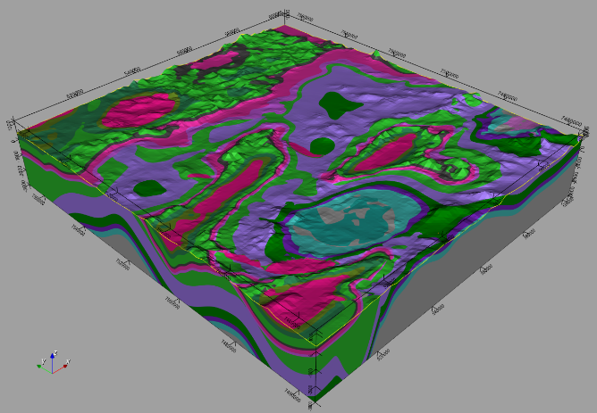


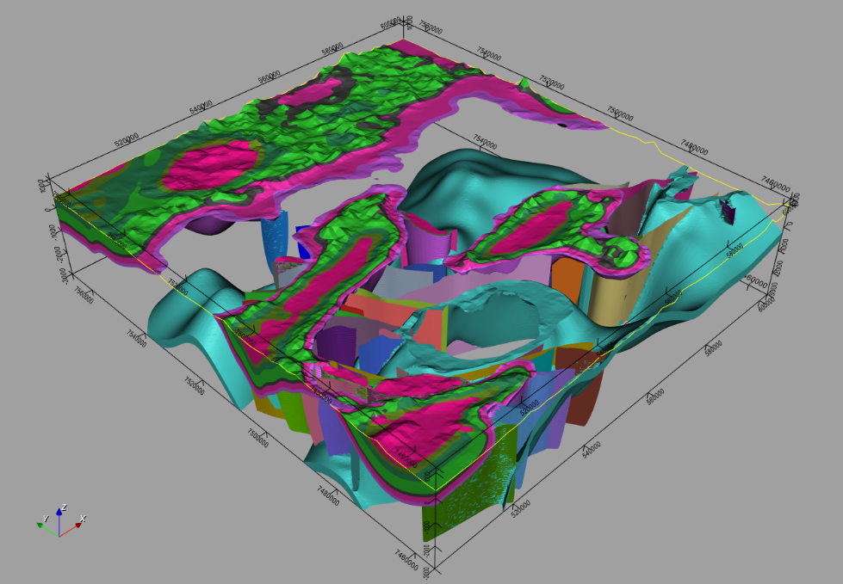
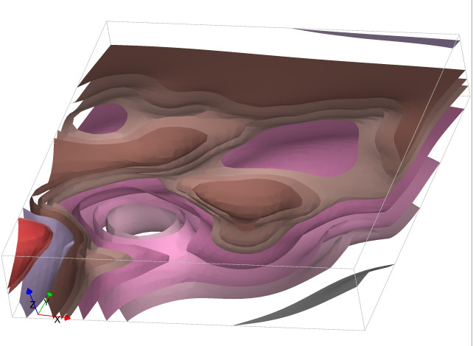
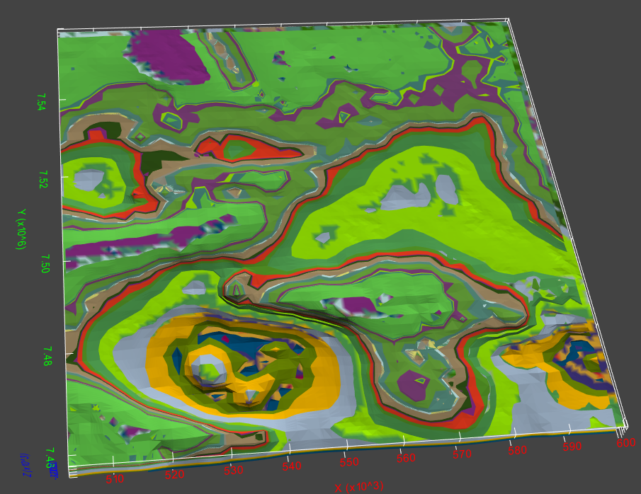
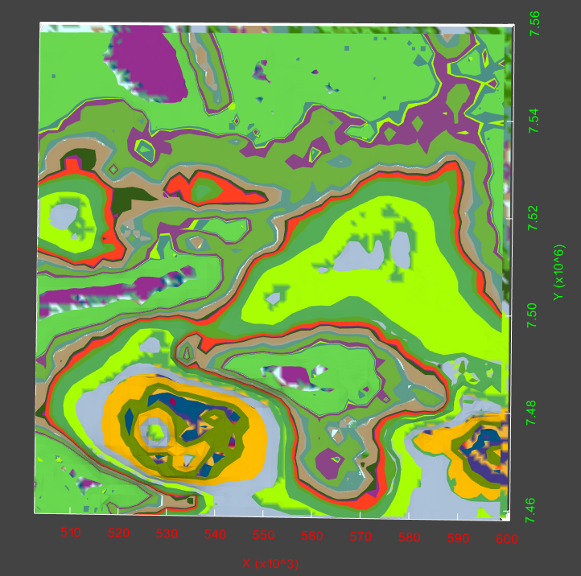
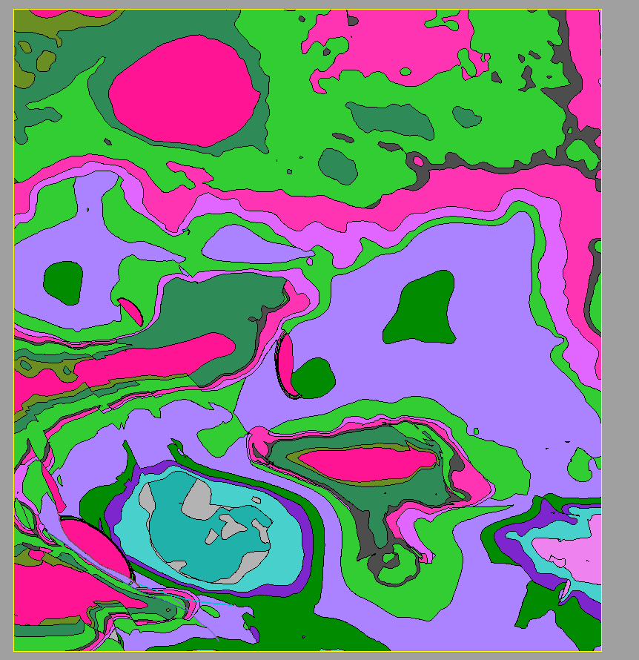
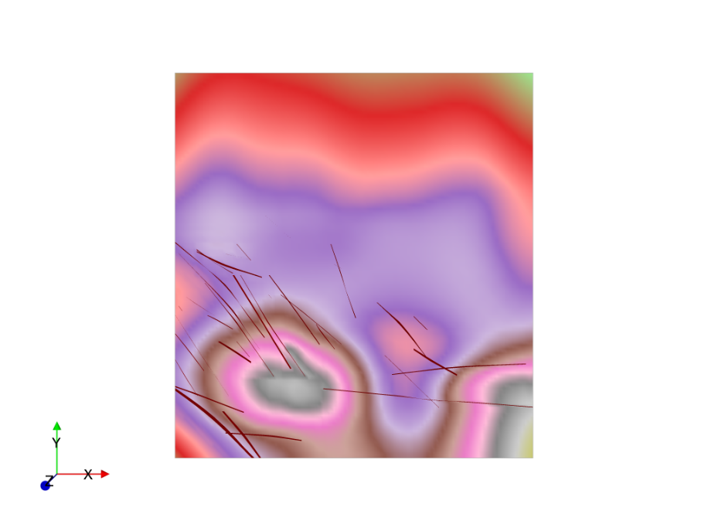

→ WP3 Model Building
geomodeller
Structural
Map

Slide 17
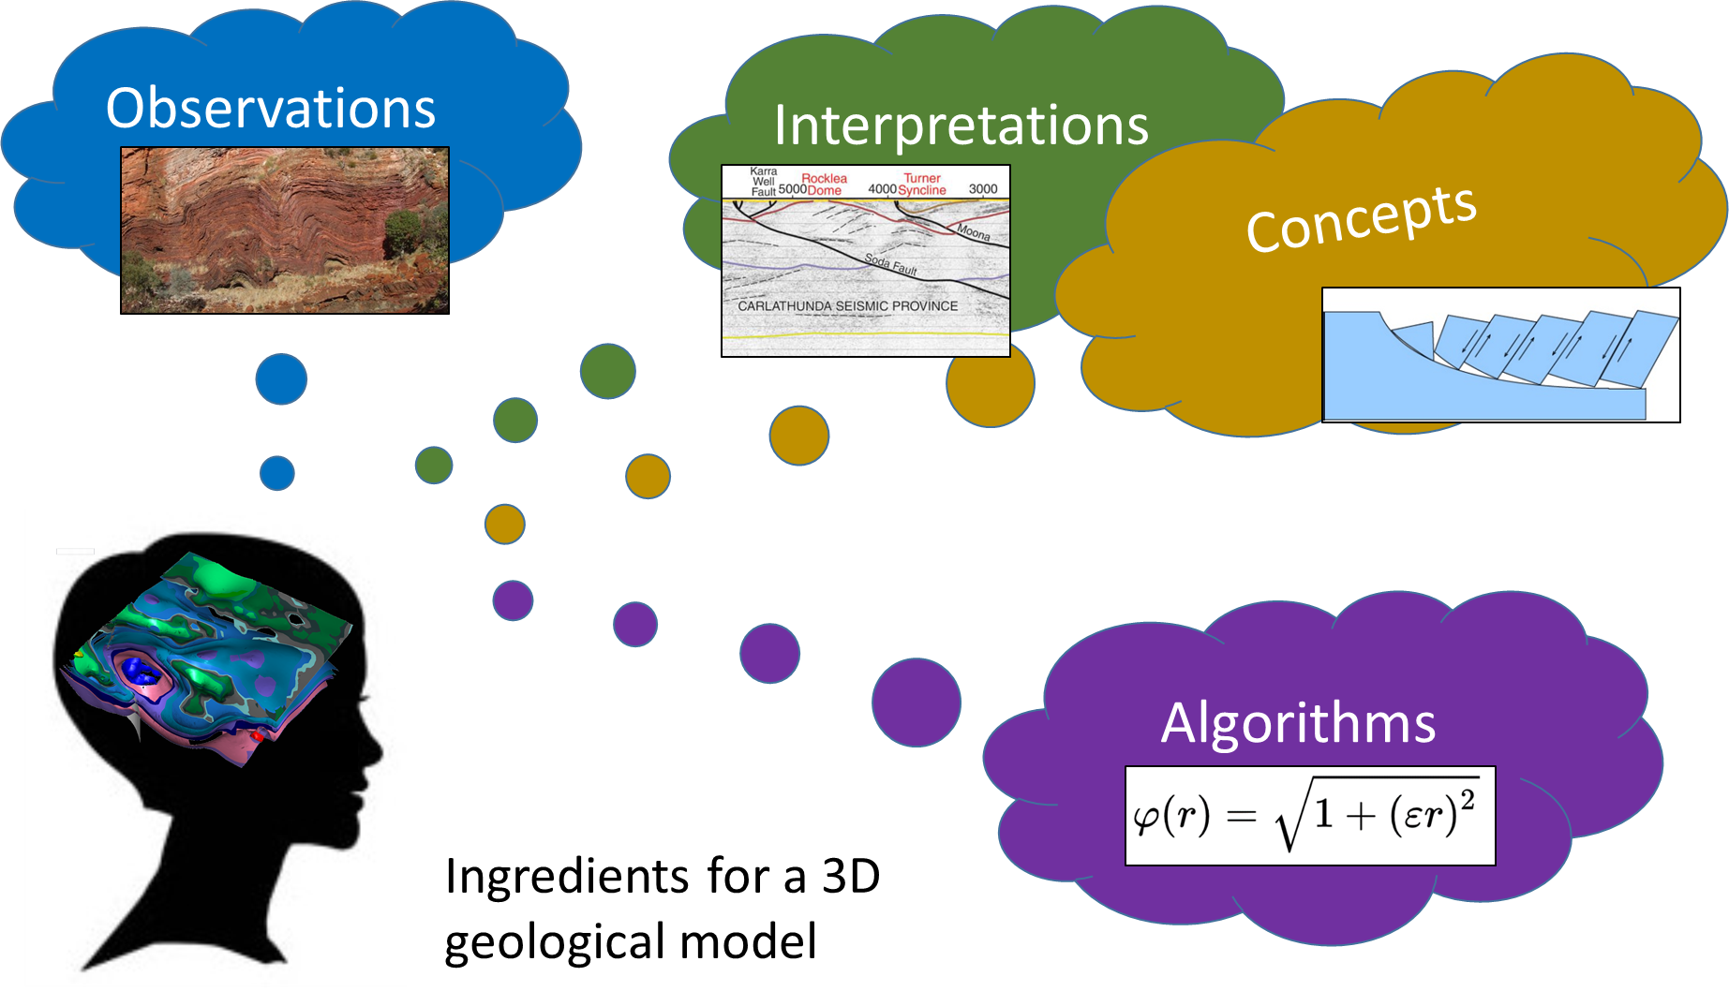
→ WP5 Uncertainty Quantification
a
r
Elicitation?
r
Concept parameterisation?
a

Slide 18
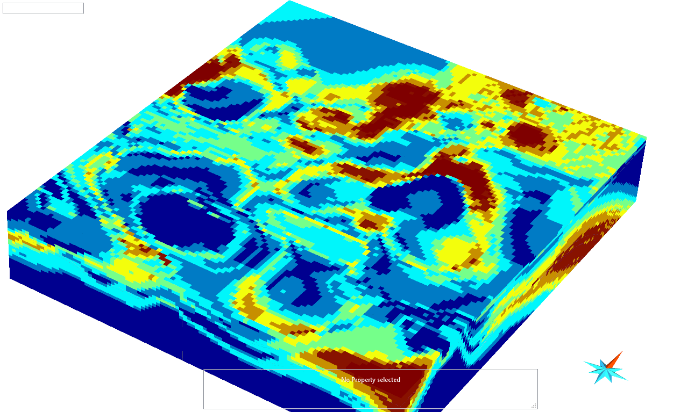
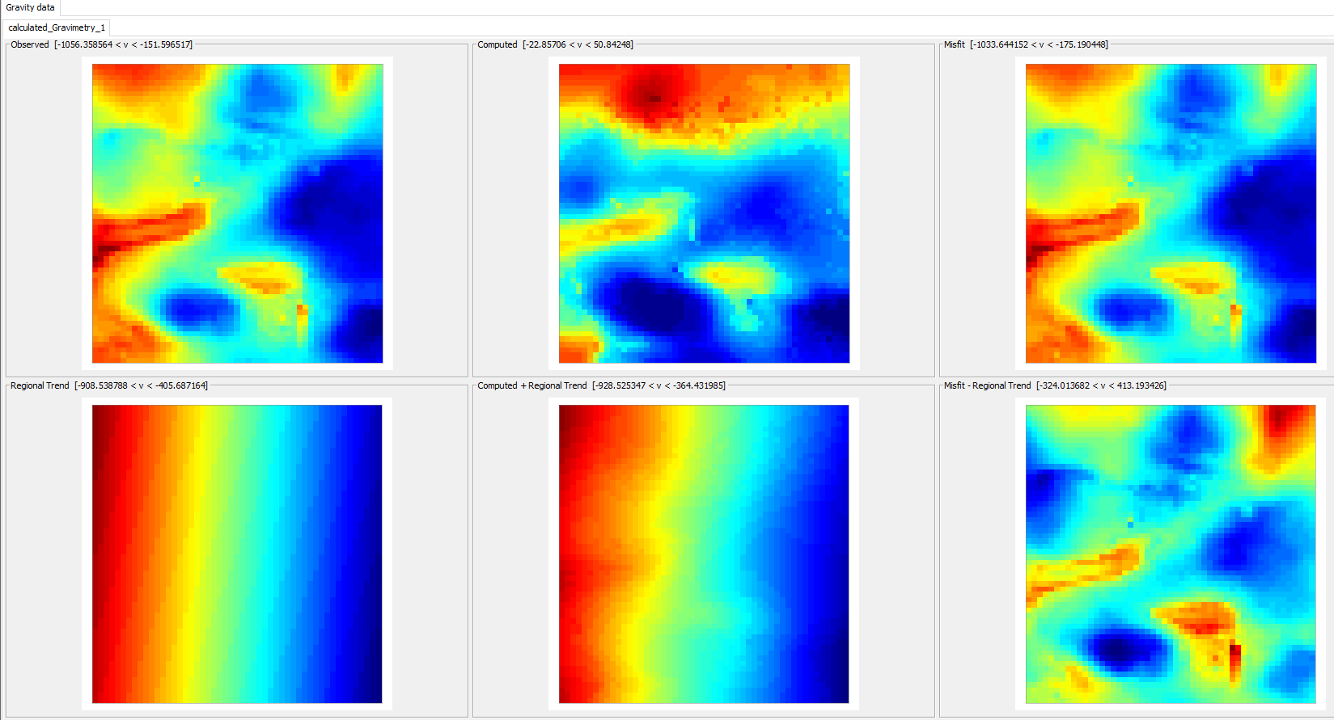
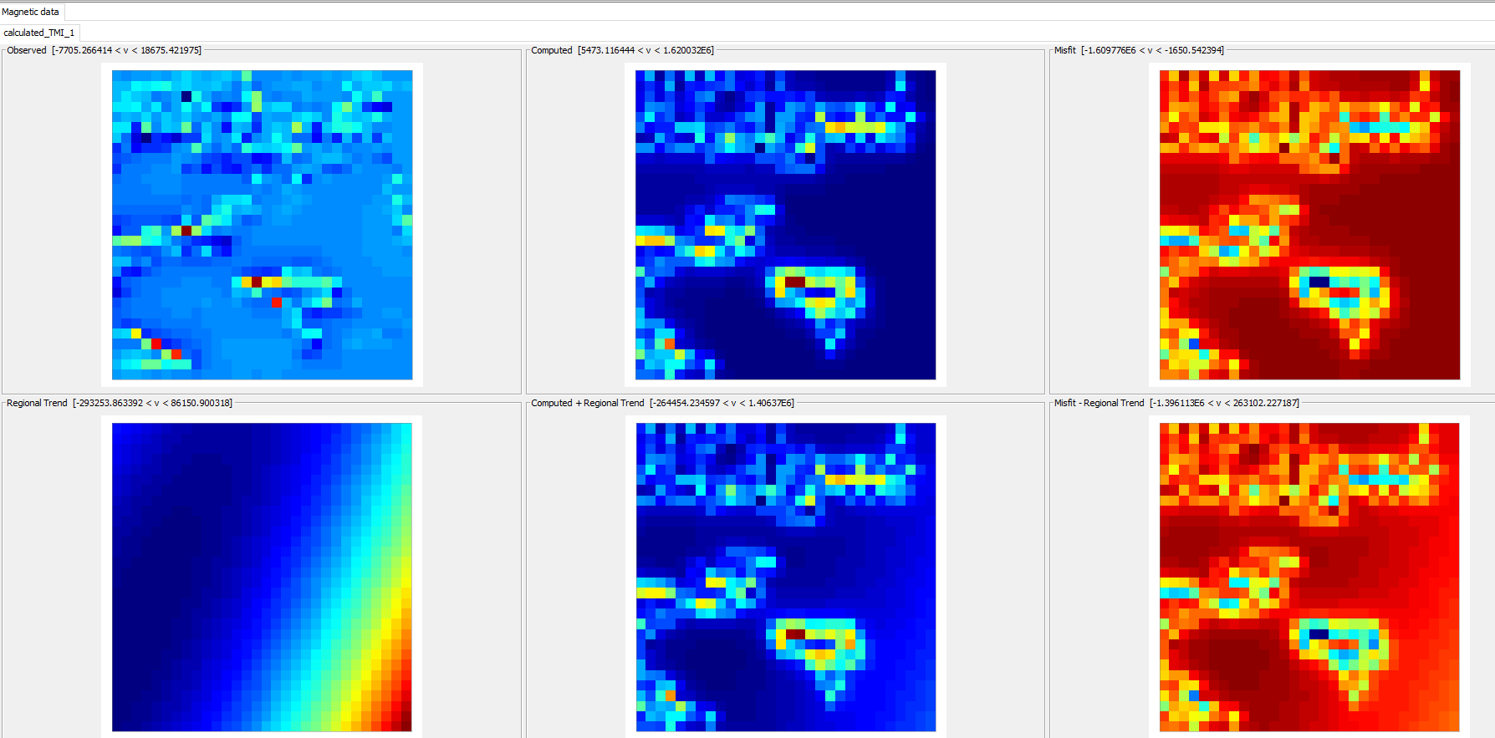
→ WP4 Geophysics Integration
Uncertainty voxet
Observed
Computed
Grav
Mag

Slide 19
What next
More robust, so it works for more than 0.0015% of the Earth’s Surface!
Data cleansing tools
Question Framing Tools
Integration of multiscale tools
WP 1
Question Framing
Data Sourcing
Data Cleansing/ Harmonisation/ Scaling
Data Extraction
WP 3
Data Perturbation
Information Extraction
WP 5
WP 1

Slide 20
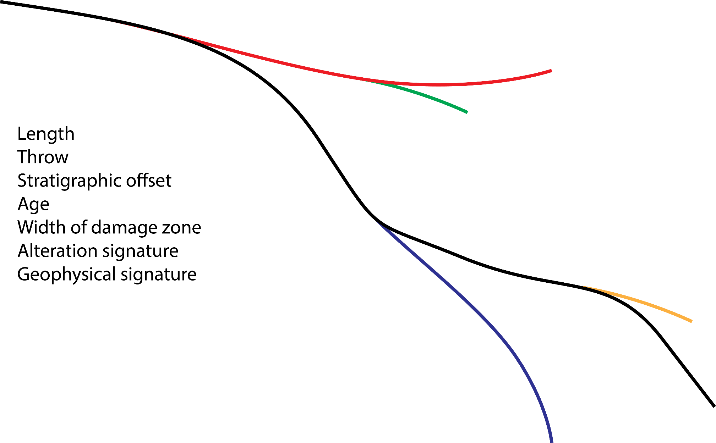
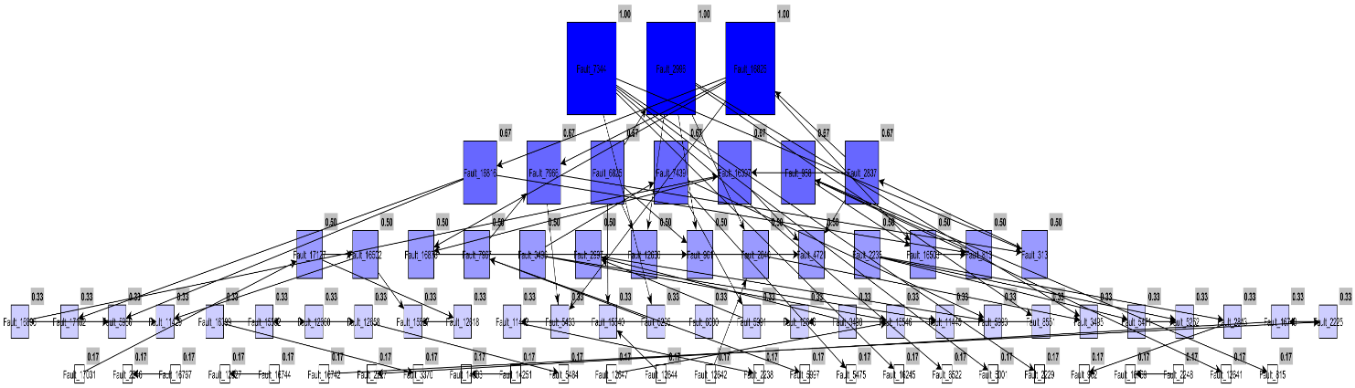
Question Framing: Which faults to model?
Length
Throw
Stratigraphic offset
Age
Width of damage zone
Alteration signature
Geophysical signature
Centrality/Order
Spatial association with mineralisation
Curvature
Number of connected edges

Slide 21
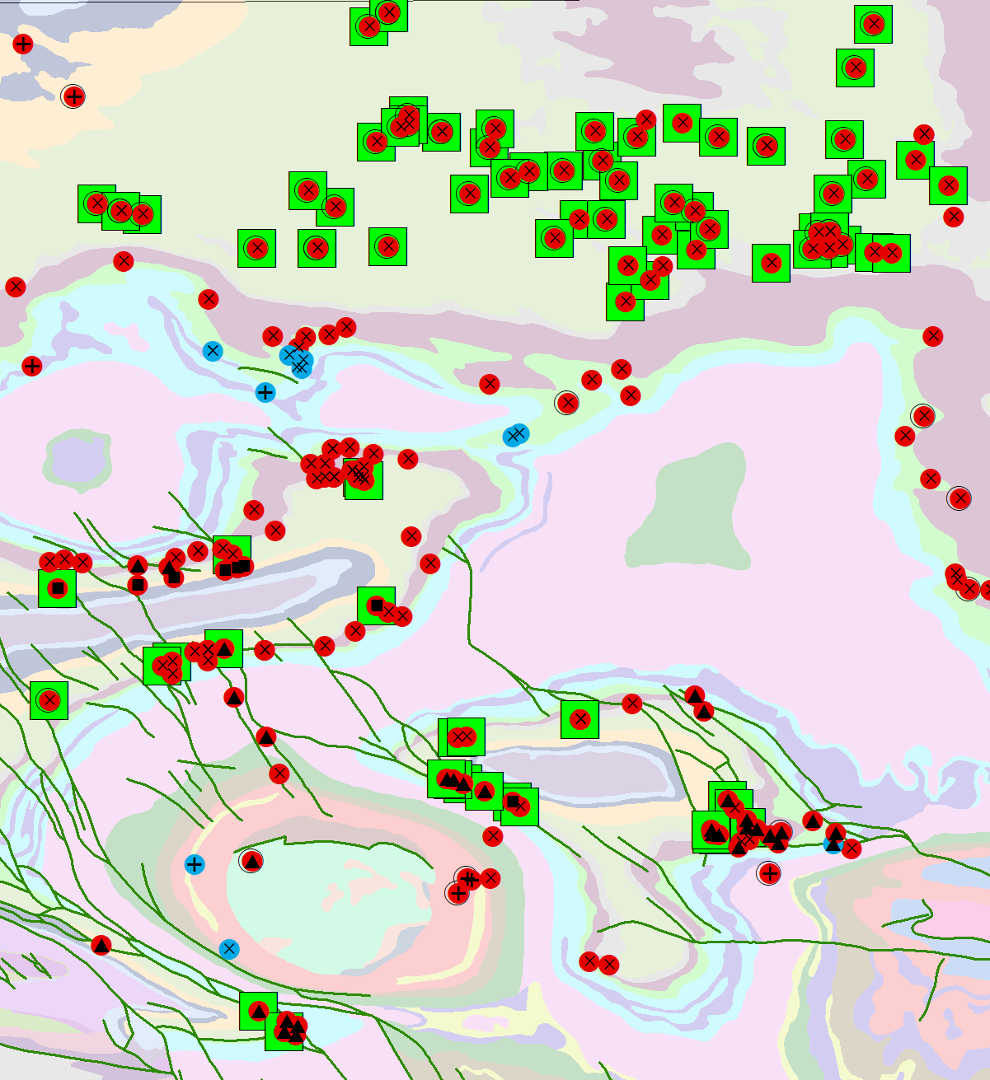
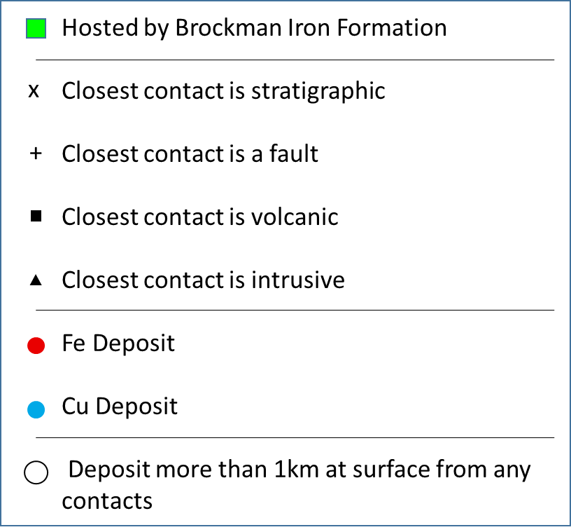
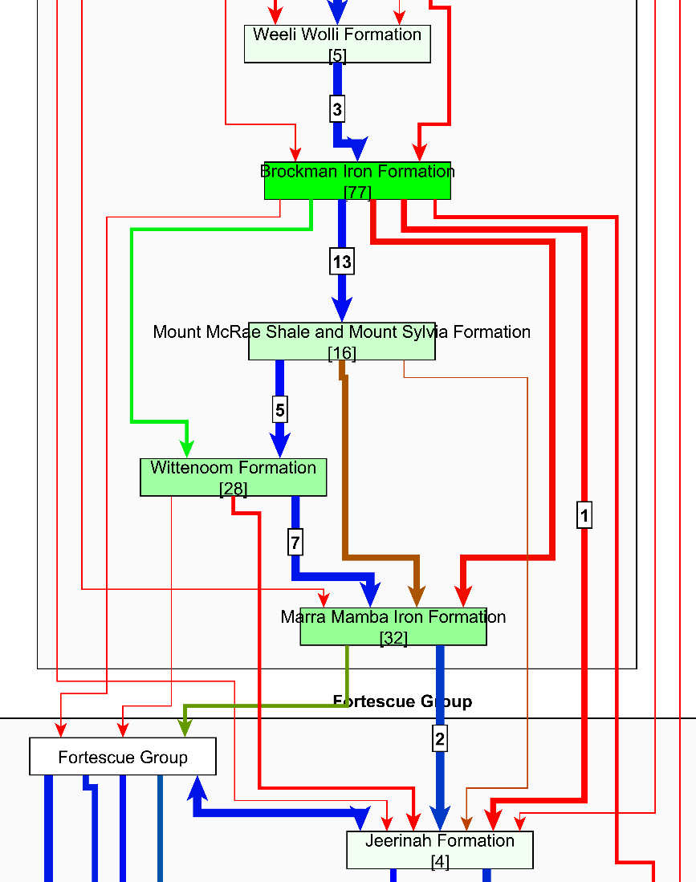
Litho-structural mineralisation context
12
Deposits on/near contact
[7]
Deposits hosted by formation
Formation
Fault Contact
Strat Contact

Slide 22
map2loop automation :
Significantly reduces the time to first prototype models;
Allows reproducible modelling from raw data, whereas current Uncertainty Quantification workflows start from model-ready inputs;
Clearly separates the primary observations, interpretations, derived data and conceptual priors during the data reduction steps; and
Provides a homogenous pathway to Sensitivity Analysis, Uncertainty Quantification, Multiscale Modelling and Value of Information studies.

Slide 23

Proof of concept, use at your own risk!

